Slide 1

At first you have to open any browser and search for “CODEBLOCKS”

Slide 2
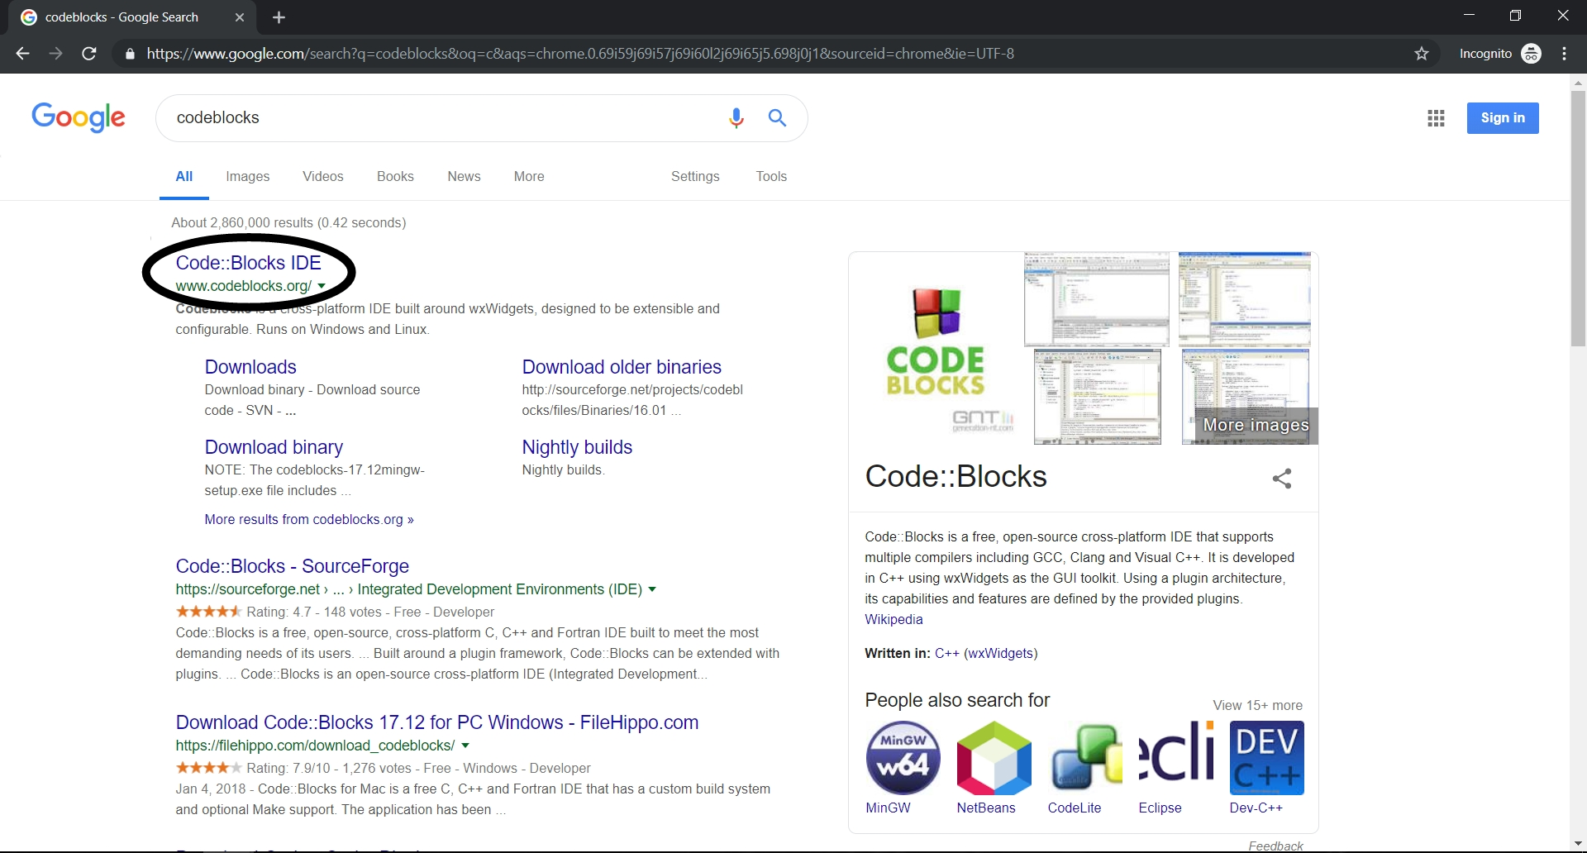
Then click on the link marked

Slide 3
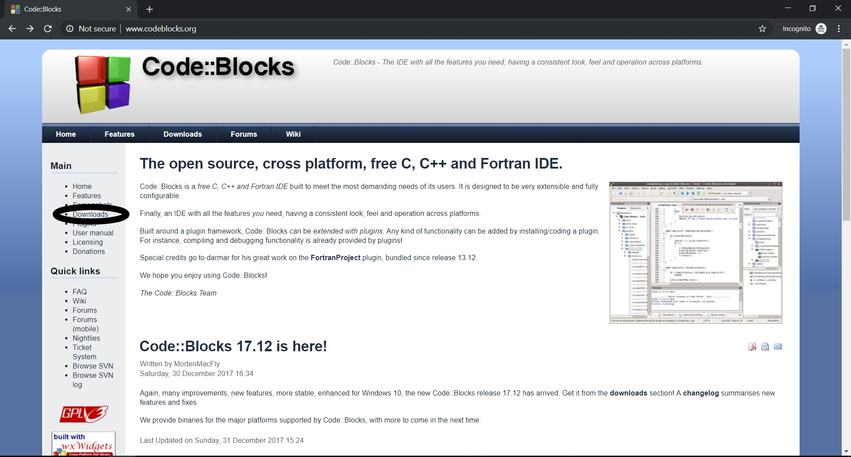
Then click on “DOWNLOADS”

Slide 4
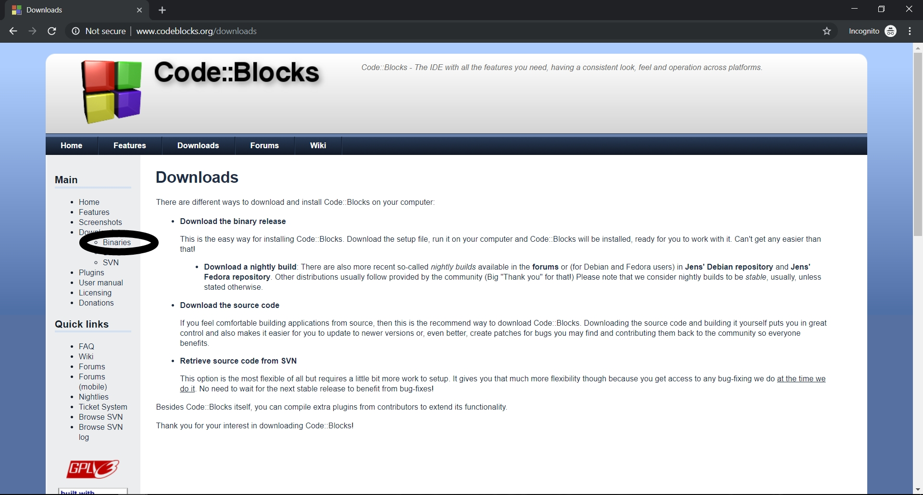
Then click on
“Binaries”

Slide 5
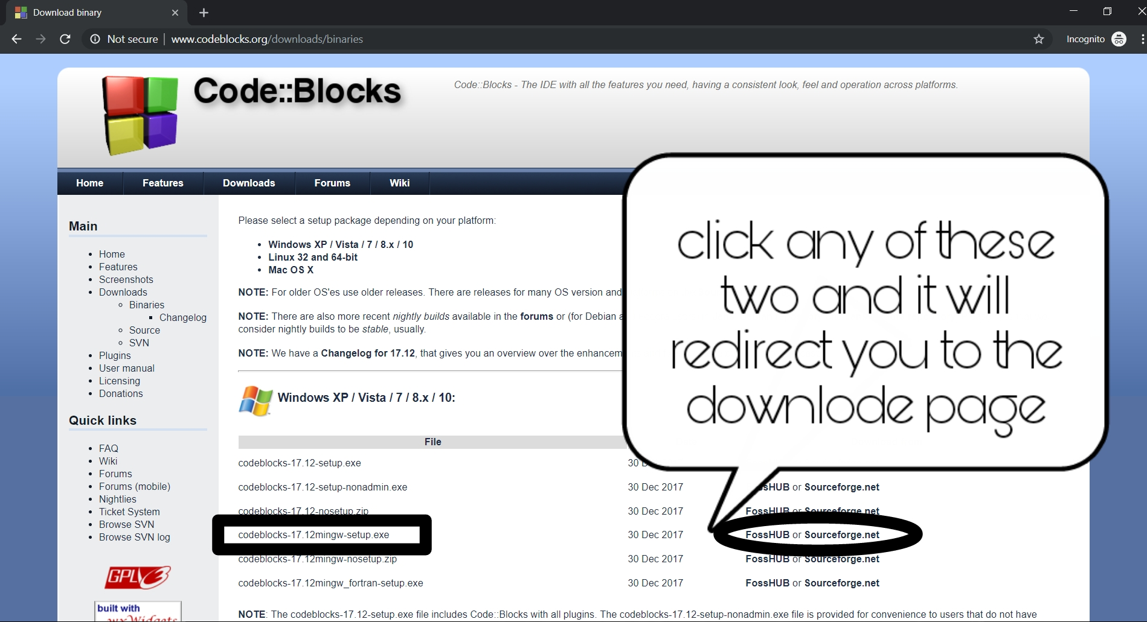
Then search for “codeblocks-17.12mingw-setup.exe”

Slide 6
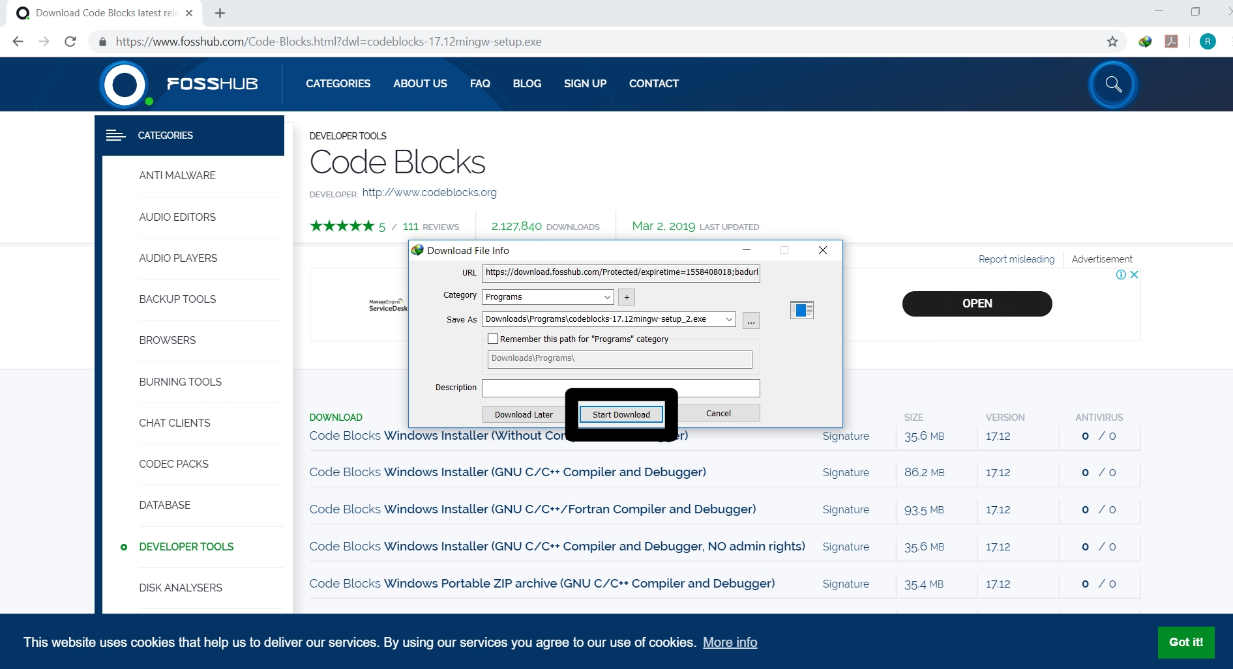
Then click on “start download”

Slide 7
After download install it like any other software or games

